Slide 1
Outland Adventures: Database System Project
Milestone 4 Presentation
Jordan Dardar
Alexander Baldree
Aftabur Rahman
Maksymillian Jankowski

Slide 2
Introduction to Outland Adventures
- Founded by Blythe Timmerson and Jim Ford
- Guided hiking and camping trips
- Destinations: Africa, Asia, Southern Europe
- Equipment rental and sales
- New e-commerce website for bookings

Slide 3
Case Study Problems to Solve
1. Are equipment sales strong enough?
2. Are any destinations trending downward?
3. Is any equipment over five years old?

Slide 4
Business Rules (Part 1)
- Customers can make multiple bookings
- Each booking belongs to one trip schedule
- Trips belong to one destination
- Destinations can have multiple trips
- Trips can have multiple scheduled dates

Slide 5
Business Rules (Part 2)
- Guides can lead multiple trips
- Each scheduled trip has one guide
- Equipment may be rented or sold
- Inventory tracks quantity and age
- Customers can rent or buy multiple items

Slide 6
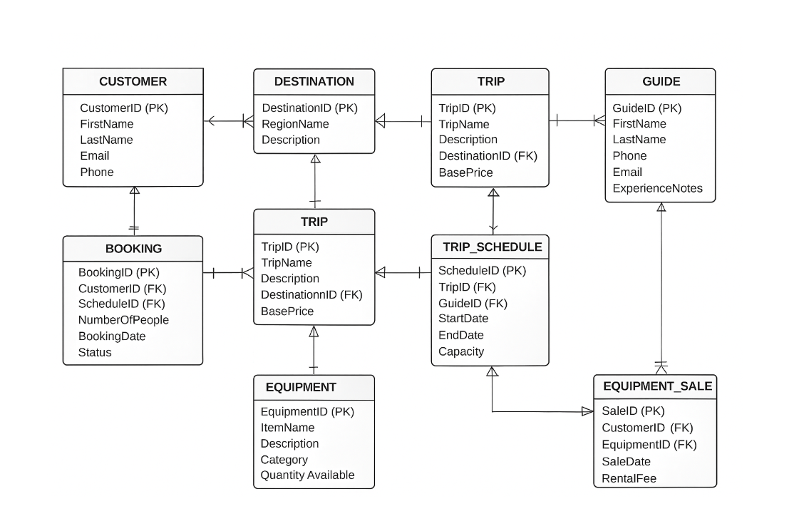
Entity-Relationship Diagram (ERD)
Database diagram representing Outland Adventures system.

Slide 7
Tables Overview
- CUSTOMER
- DESTINATION
- TRIP
- GUIDE
- TRIP_SCHEDULE
- BOOKING
- EQUIPMENT
- EQUIPMENT_RENTAL
- EQUIPMENT_SALE

Slide 8
Report 1: Equipment Sales by Month
Description:
This report shows how many pieces of equipment were sold each month and how much money those sales brought in. It groups the sales by month and adds up both the number of items sold and the total revenue for that month. This helps Outland Adventures see whether customers are still buying equipment on a regular basis or if sales are slowing down.
Why it matters:
One of the main questions from the case study is whether equipment sales are strong enough to justify continuing the sales portion of the business. By measuring monthly equipment sales, the company can see if sales are steady, increasing, or dropping off, which helps Blythe and Jim decide if they should keep selling gear, expand the inventory, or reduce the sales operation.
Evaluates monthly sales and revenue trends.
Determines if equipment sales should continue.

Slide 9
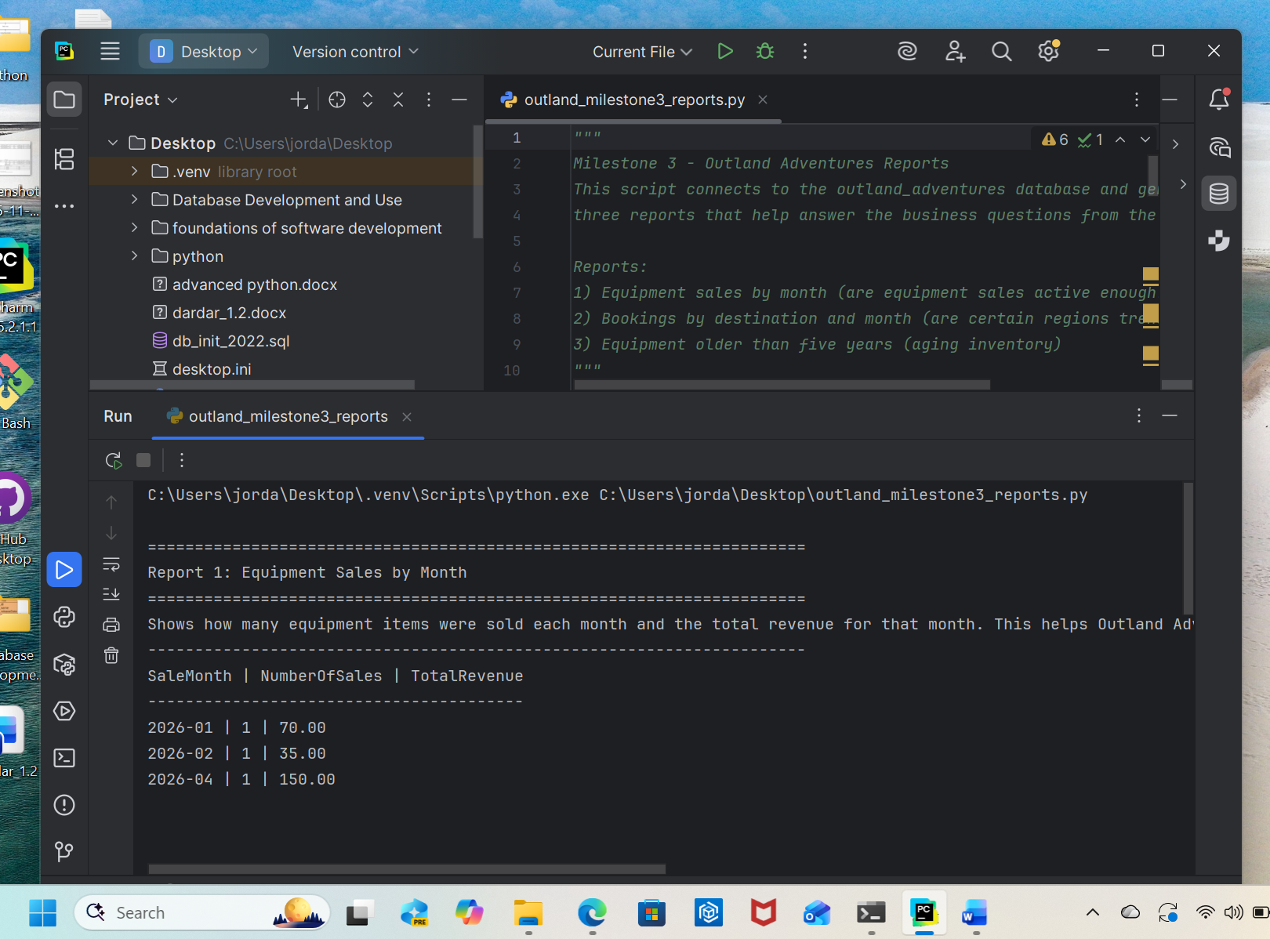


Slide 10
Report 2: Bookings by Destination & Month
Description:
This report shows how many bookings each region (Africa, Asia, or Southern Europe) receives each month. It pulls booking information, connects it to the scheduled trips, and then ties those trips back to their destination regions. It organizes the results by region and month so it is easy to compare how each area is performing over time.
Why it matters:
The case study mentions that Blythe and Jim want to know if any of their main regions are showing a downward trend in bookings. By looking at the number of bookings per month for each destination, they can quickly identify whether interest in Africa, Asia, or Southern Europe is increasing or falling. This helps them make decisions about advertising, staffing guides, or possibly removing or replacing underperforming trips.
Shows booking trends by region.
Identifies declining destinations.

Slide 11
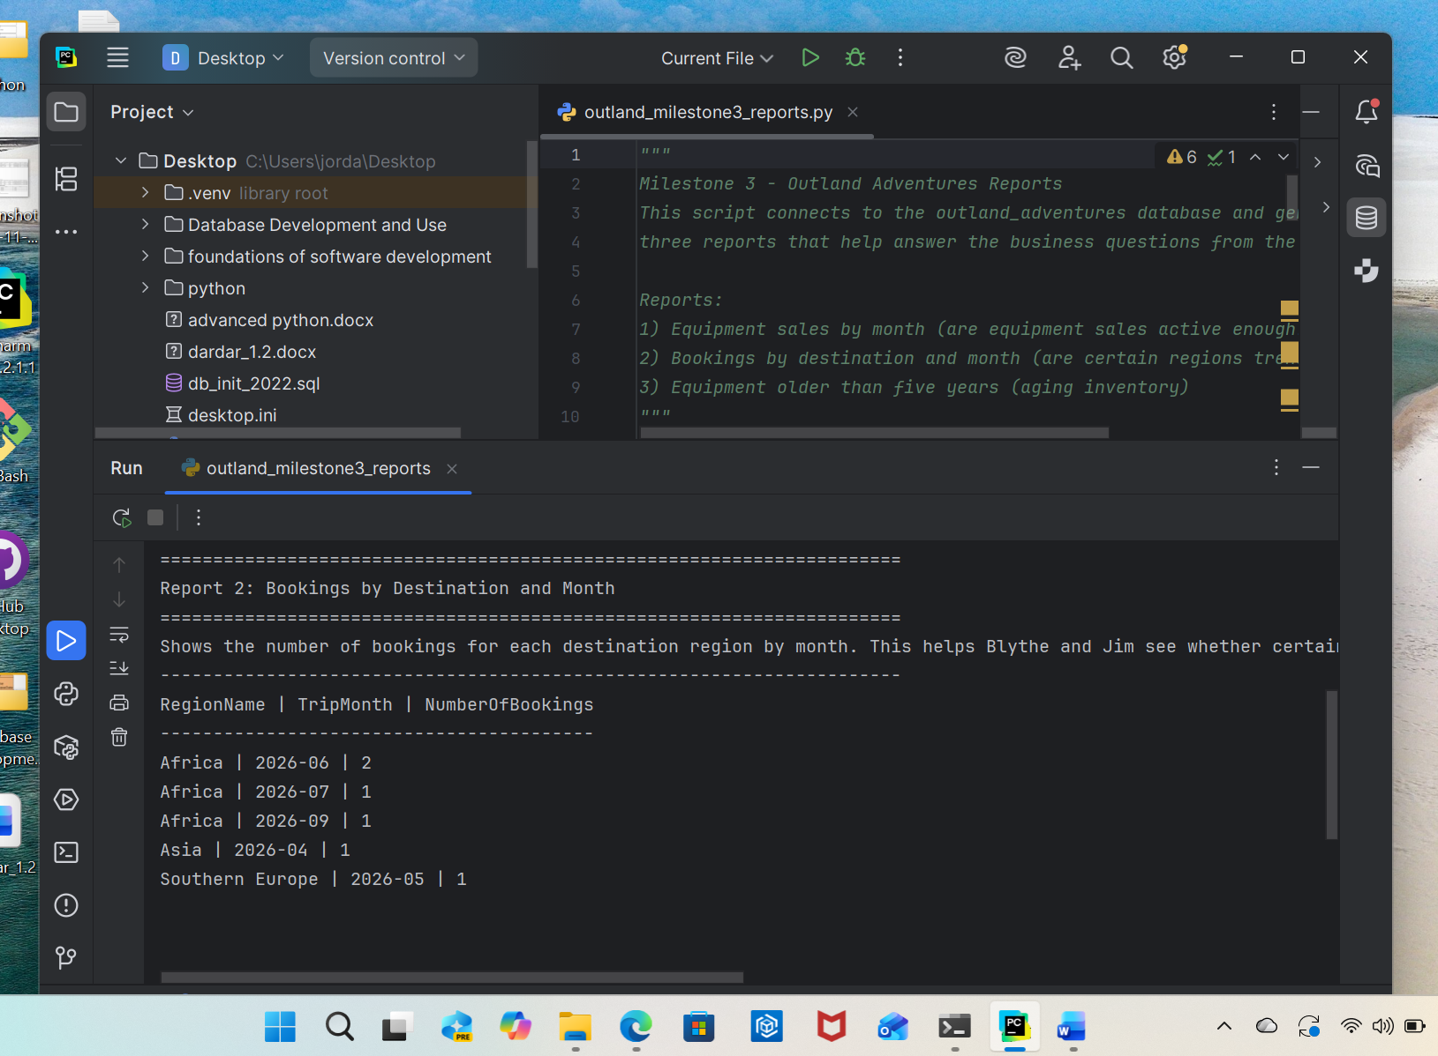

Slide 12
Report 3: Equipment Over Five Years Old
Description:
This report lists all equipment items that are more than five years old. It shows the item name, the type of equipment, the quantity currently available, and how old the equipment is. This helps identify older items that may not be reliable anymore or that may need to be replaced soon.
Why it matters:
The case study mentions that Outland Adventures is worried about the age of some of their equipment. Older gear can be unsafe, unreliable, or less attractive to customers. By identifying which items are past five years of age, the company can decide what to replace, what to repair, and how to manage their inventory so customers always receive safe, high-quality equipment.
Lists aging or potentially unsafe equipment.
Helps with replacement decisions.

Slide 13
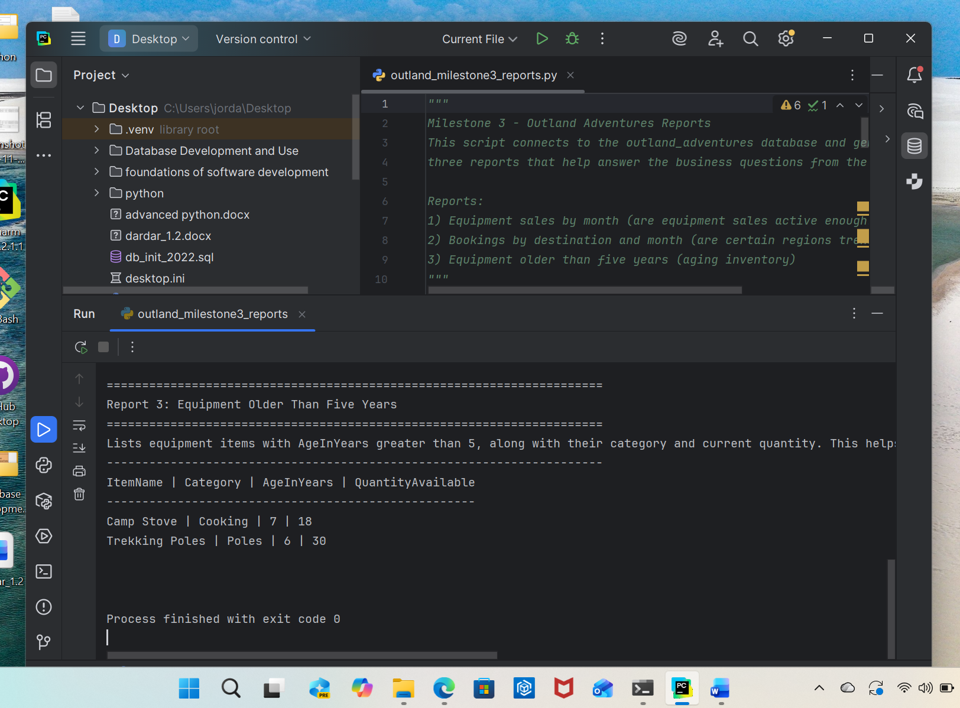

Slide 14
Key Findings
- Monthly equipment sales trends observed
- Destination booking patterns identified
- Old equipment flagged for replacement

Slide 15
Recommendations
- Maintain or adjust equipment sales strategy
- Improve marketing for low-performing regions
- Replace equipment older than five years
- Continue to develop e-commerce presence

Slide 16
Conclusion
Our database system organizes key business data,
answers critical questions, and supports future growth.
Thank you!

